Slide 1
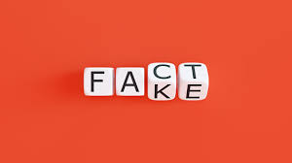

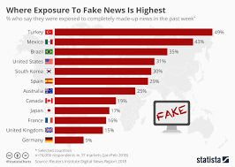
Ending slide
Fake News Detection
Notes:
This slide contains the editable pieces that were used to build infographic sample
Icons – Eye, PC

Slide 2
FAKE NEWS DETECTION
Fake news is false or misleading information presented as news. Fake news often has the aim of damaging the reputation of a person or entity, or making money through advertising revenue. Although false news has always been spread throughout history, the term "fake news" was first used in the 1890s when sensational reports in newspapers were common. Nevertheless, the term does not have a fixed definition and has been applied broadly to any type of false information. It's also been used by high-profile people to apply to any news unfavorable to them. Fake news is false or misleading information presented as news. Fake news often has the aim of damaging the reputation of a person or entity, or making money through advertising revenue. Although false news has always been spread throughout history, the term "fake news" was first used in the 1890s when sensational reports in newspapers were common. Nevertheless, the term does not have a fixed definition and has been applied broadly to any type of false information. It's also been used by high-profile people to apply to any news unfavorable to them.

Slide 3
PROJECT BUILDING
1. The Data Set
The dataset used in this article is taken from Kaggle that is publically available as the Fake and real news dataset. This data set has two CSV files containing true and fake news. Each having Title, text, subject and date attributes. There are 21417 true news data and 23481 fake news data given in the true and fake CSV files respectively. To train the model for classification, we will add a column in both the datasets as real or fake.
2. We will import all the required libraries.
PANDAS: As we know that the dataset must be prepared before training. In this case, Pandas comes handy as it was developed specifically for data extraction and preparation.
NUMPY: NumPy is a very popular python library for large multi-dimensional array and matrix processing, with the help of a large collection of high-level mathematical functions.
SKLEARN:
Scikit-learn is one of the most popular ML libraries for classical ML algorithms. It is built on top of two basic Python libraries, viz., NumPy and SciPy. Scikit-learn supports most of the supervised and unsupervised learning algorithms. Scikit-learn can also be used for data-mining and data-analysis, which makes it a great tool who is starting out with ML.

Slide 4
PROJECT BUILDING
3. After importing the libraries, we will read the CSV files in the program.
#Reading CSV files
true = pd.read_csv("True.csv")
fake = pd.read_csv("Fake.csv")
4. Here, we will add fake and true labels as the target attribute with both the datasets and create our main data set that combines both fake and real datasets.
#Specifying fake and real
fake['target'] = 'fake’
True['target'] = 'true’
5. Concatenate dataframes, Here we concatenate both fake and true data as news
news = pd.concat([fake, true]).reset_index(drop = True)
news.shape
6. After specifying the main dataset, we will define the train and test data set by splitting the main data set.
We have kept 20% of the data for testing the classifiers. This can be adjusted accordingly.
#Train-test split
x_train,x_test,y_train,y_test = train_test_split(news['text’],
news.target, test_size=0.2, random_state=1)

Slide 5
PROJECT BUILDING
In the next step, we will classify the news texts as fake or true using classification algorithms.
We will perform this classification using three algorithms one by one.
First, we will obtain the term frequencies and count vectorizer that will be included as input attributes for the classification model and the target attribute that we have defined above will work as the output attribute.
To bind the count vectorizer, TF-IDF and classification model together, the concept of the pipeline is used.
A machine learning pipeline is used to help automate machine learning workflows.
They operate by enabling a sequence of data to be transformed and correlated together in a model that can be tested and evaluated to achieve an outcome, whether positive or negative.
TF-IDF stands for “Term Frequency — Inverse Document Frequency”.
Machine learning algorithms often use numerical data, so when dealing with textual data or any natural language processing (NLP) task, a sub-field of ML/AI dealing with text, that data first needs to be converted to a vector of numerical data by a process known as vectorization. TF-IDF vectorization involves calculating the TF-IDF score for every word in your corpus relative to that document and then putting that information into a vector.

Slide 6
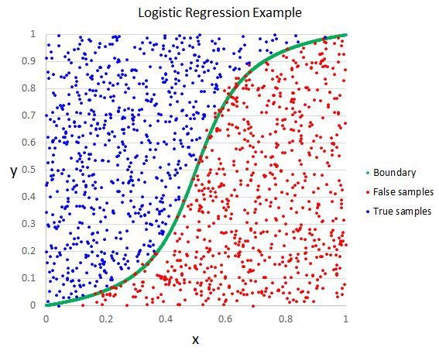
LOGISTIC REGRESSION
In the first step, we will classify the news text using the Logistic Regression model and evaluate its performance using evaluation matrices.
Logistic regression is one of the most popular Machine Learning algorithms, which comes under the Supervised Learning technique. It is used for predicting the categorical dependent variable using a given set of independent variables.
Logistic regression predicts the output of a categorical dependent variable. Therefore the outcome must be a categorical or discrete value. It can be either Yes or No, 0 or 1, true or False, etc. but instead of giving the exact value as 0 and 1, it gives the probabilistic values which lie between 0 and 1.
#Logistic regression classification
pipe1 = Pipeline([('vect', CountVectorizer()),('tfidf', TfidfTransformer()),('model', LogisticRegression())])
model_lr = pipe1.fit(x_train, y_train)
lr_pred = model_lr.predict(x_test)
print("Accuracy of Logistic Regression Classifier: {}%".format(round(accuracy_score(y_test, lr_pred)*100,2)))
print("\nConfusion Matrix of Logistic Regression Classifier:\n")
print(confusion_matrix(y_test, lr_pred))
print("\nCLassification Report of Logistic Regression Classifier:\n")
print(classification_report(y_test, lr_pred))

Slide 7
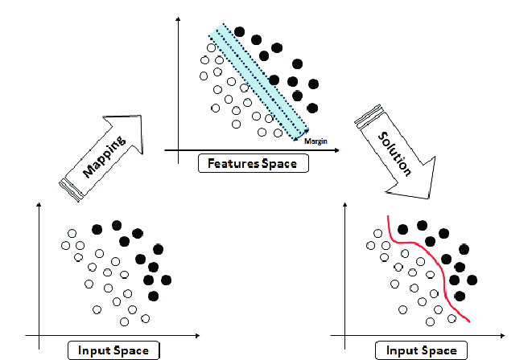
SVM(SUPPORT VECTOR CLASSIFIER)
Support Vector Machine(SVM) is a supervised machine learning algorithm used for both classification and regression. Though we say regression problems as well its best suited for classification. The objective of SVM algorithm is to find a hyperplane in an N-dimensional space that distinctly classifies the data points. The dimension of the hyperplane depends upon the number of features. If the number of input features is two, then the hyperplane is just a line. If the number of input features is three, then the hyperplane becomes a 2-D plane. It becomes difficult to imagine when the number of features exceeds three.
#Support Vector classification
pipe2 = Pipeline([('vect', CountVectorizer()), ('tfidf', TfidfTransformer()), ('model', LinearSVC())])
model_svc = pipe2.fit(x_train, y_train)
svc_pred = model_svc.predict(x_test)
print("Accuracy of SVM Classifier: {}%".format(round(accuracy_score(y_test, svc_pred)*100,2)))
print("\nConfusion Matrix of SVM Classifier:\n")
print(confusion_matrix(y_test, svc_pred))
print("\nClassification Report of SVM Classifier:\n")
print(classification_report(y_test, svc_pred))

Slide 8
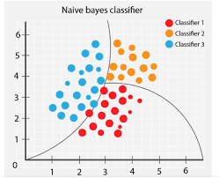
3.Naïve Bayes Classifier Algorithm
Naïve Bayes algorithm is a supervised learning algorithm, which is based on Bayes theorem and used for solving classification problems.
It is mainly used in text classification that includes a high-dimensional training dataset.
Naïve Bayes Classifier is one of the simple and most effective Classification algorithms which helps in building the fast machine learning models that can make quick predictions.
It is a probabilistic classifier, which means it predicts on the basis of the probability of an object.
Some popular examples of Naïve Bayes Algorithm are spam filtration, Sentimental analysis, and classifying articles.

Slide 9
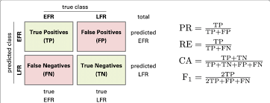
Actual positive(1)
Actual negative (0)
Predicted positive(1)
TRUE POSITIVE | FALSE POSITIVE
FALSE NEGATIVE | TRUE NEGATIVE
Predicted Negative(0)

Slide 10
